Slide 1
ASPN Renal Pathology Course
Case # 11
May 2022
ASPN Member Education Committee
Joann Spinale Carlson, MD
Robin Kremsdorf, MD
Shina Menon, MD
Brian Stotter, MD
Patrick D. Walker, MD

Slide 2
Introduction to the Path Course
First Monday of every odd month alternating with Radiology Conference (next Radiology Conference Date: June 7th)
3 PM Eastern Standard Time
12 core lectures including audience choice and stump the pathologist
We encourage participation! Please ask questions and add comments in the chat box.
If there is background noise:
  Please mute your phone/computer
  Otherwise, please use the microphone so you can participate

Slide 3
Case Presentation:
6 yo with heart transplant and rising serum creatinine

Slide 4
Case History
6 yo/M, w/h/o hypoplastic left heart, s/p orthotopic heart transplant at age 3, referred to nephrology clinic for rising creatinine
Medications: Sirolimus, Tacrolimus, Magnesium supplement
  Enalapril discontinued by txp team before nephrology clinic
No H/o fever, hematuria, dysuria, decreased urine output
No shortness of breath, edema

Slide 5
Past history
Heart transplant in 2014, at age 3
Post op Day 10: acute Ab mediated rejection, resolved with a course of rituximab, bortezomib, steroids
  Resolution confirmed by a negative biopsy after treatment
Also has h/o balloon dilatation of the SVC in 2016 (1 year prior to presentation), f/b balloon dilatation of the arch

Slide 6
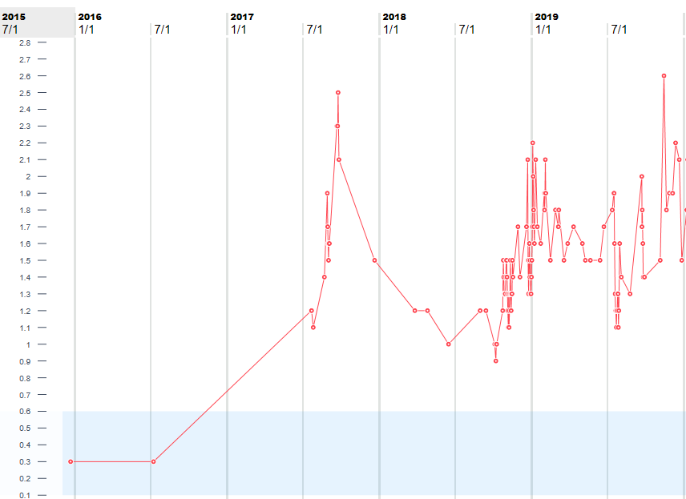
Kidney function
Baseline creatinine: 0.3-0.4
Starts increasing in summer 2017→ enalapril discontinued
Nephrology appt
Enalapril d/c

Slide 7
Poll 1: What is your leading differential diagnosis? Choose one answer
Calcineurin toxicity
Thrombotic Microangiopathy
Acute Tubular Injury
Infection (specify in chat)
Other (specify in chat)

Slide 8
Poll 2: What additional work up would you recommend?
May choose more than one option
Renal ultrasound
Urinalysis with microscopy
Drug levels
CBC with peripheral smear
Viral studies (specify)

Slide 9
Additional labs
138 108 39
------------------------------- Ca/Mg/P : 9.4/2/3.2 Hb/Hct 10.2/30.3; Platelets 335
4.3 29 2.1
Urinalysis: 1015, negative protein, Trace blood with 0-2 RBCs, otherwise negative.
Sirolimus level 5.1
Tacrolimus level 7.2
LDH normal

Slide 10
Renal ultrasound
Right kidney measuring 6.8 cm (previous 8 cm), left kidney measuring 7.4 cm (previous 7 cm). Position and contour normal. Parenchymal echogenicity is normal bilaterally, new right-sided parenchymal thinning. No collecting system dilatation. No distal ureteral dilation at the level of the partially distended urinary bladder.
Bilateral tardus parvus waveforms within the kidneys without evidence of focal narrowing with either main renal artery, may reflect a result of overall poor perfusion.

Slide 11
Viruses
July 2017: Urine BK > 5,000,000 (log 6.7)
              Serum BK : negative
Aug 2017: Urine BK > 5,000,000 (log 6.7)
              Serum BK : 5,011,872 (log 6.7)
CMV PCR, EBV PCR both negative

Slide 12
What would you do now?
Add comments in chat

Slide 13
Kidney biopsy was done

Slide 14
Renal Biopsy
Dr. Pat Walker

Slide 15
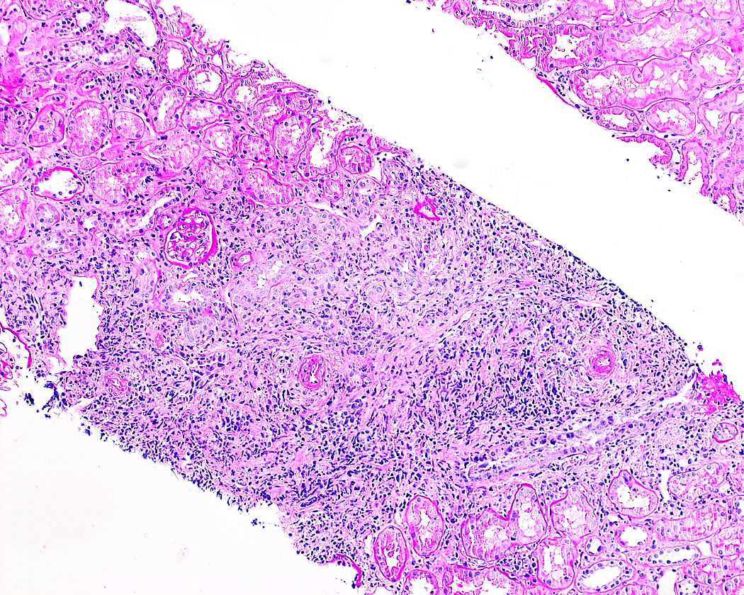
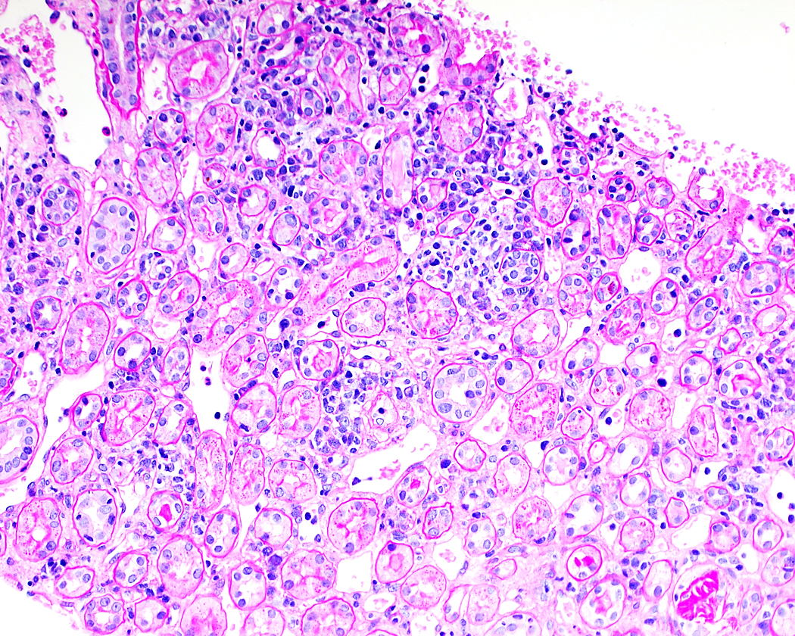

Slide 16
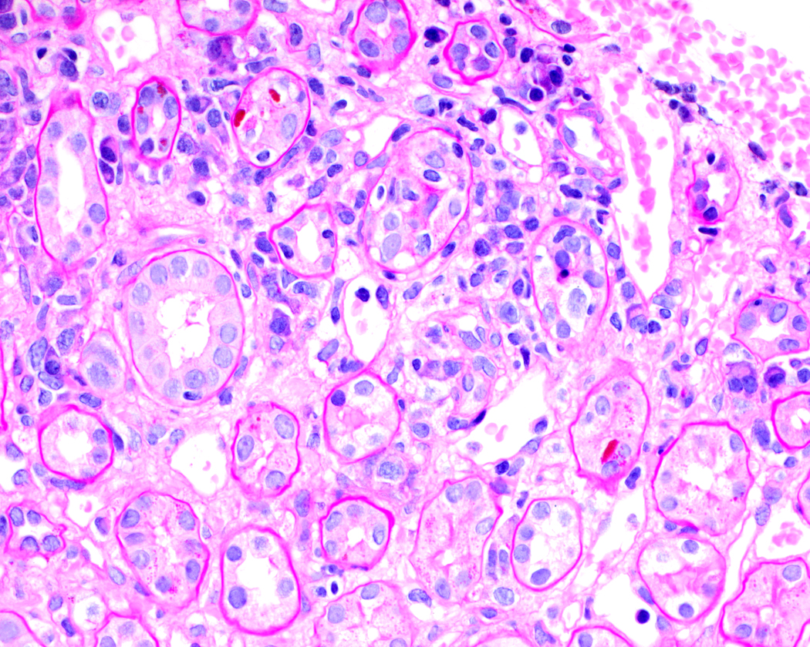
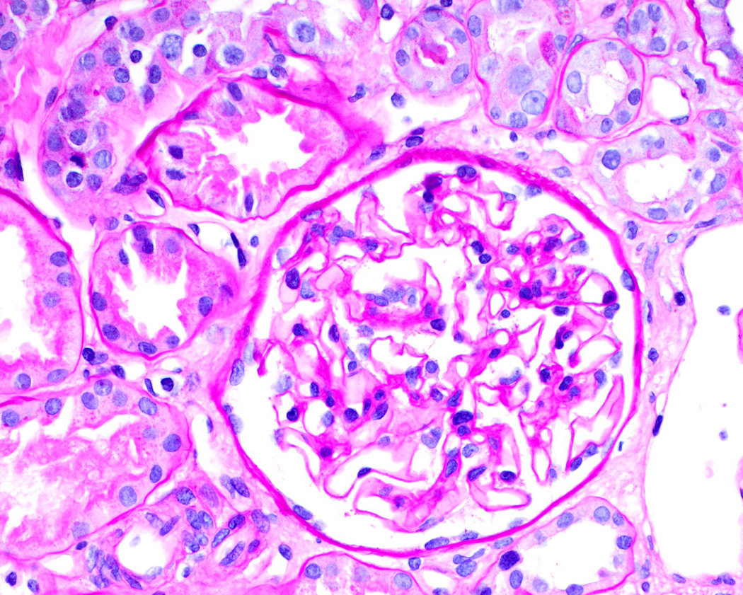

Slide 17
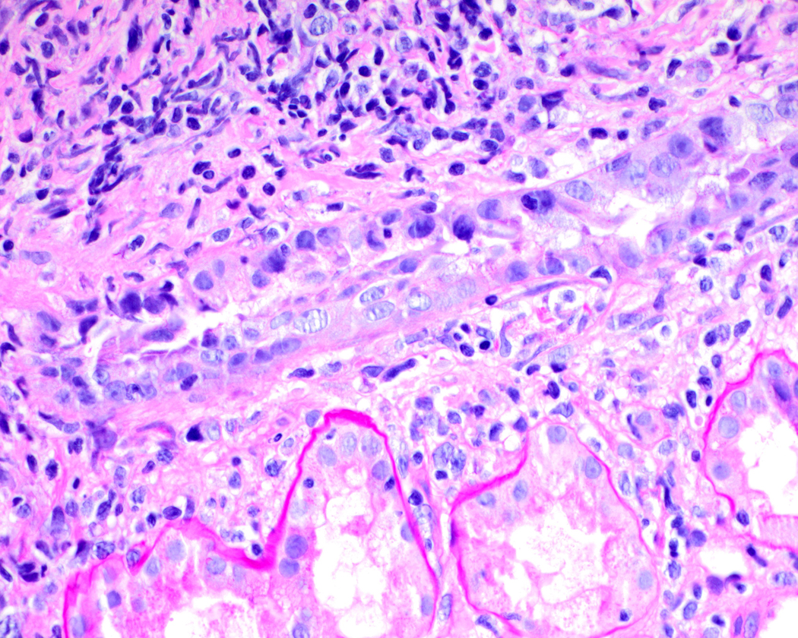
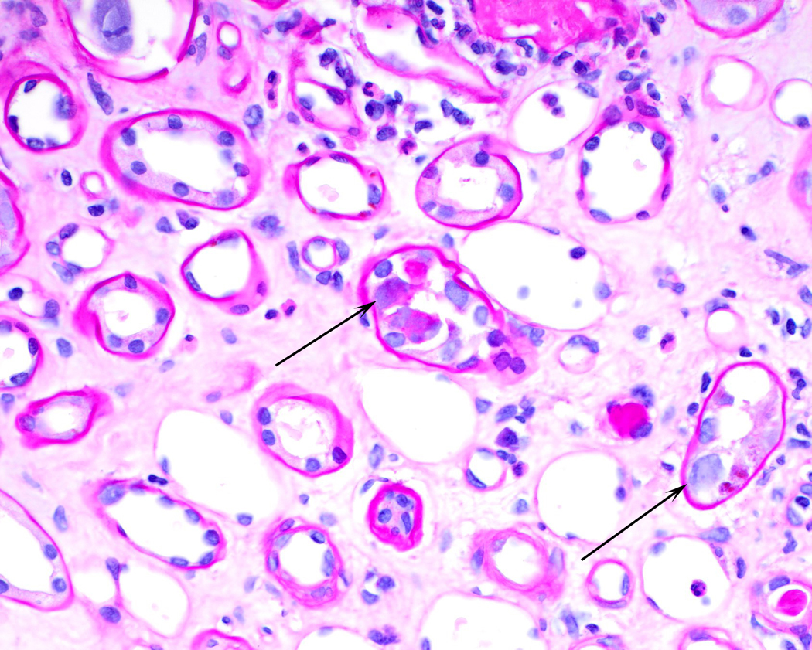
Viral Nuclear Change

Slide 18
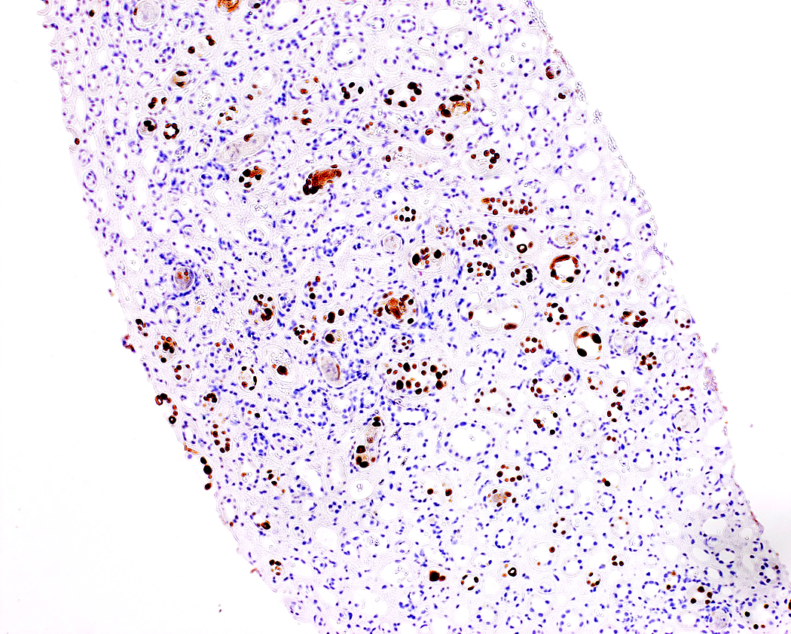
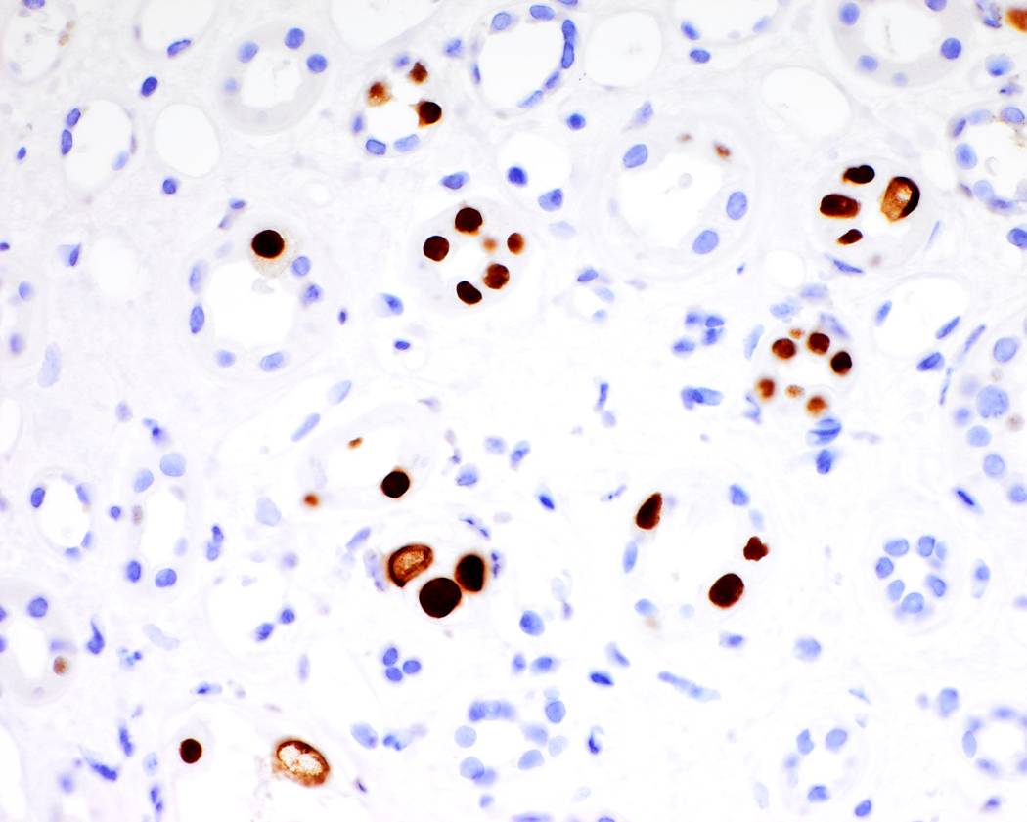
SV40 stain for Polyoma Virus

Slide 19
Immunofluorescence Microscopy
Negative
  IgG, IgM, IgA, C3, C1q, C4, Fibrinogen
Electron Microscopy
No Changes

Slide 20
Biopsy Diagnosis
BK Nephritis

Slide 21
Non-Renal Solid Organ Transplants
Renal biopsy for any indication in this population
Always stain with SV40 for polyoma virus

Slide 22
Content Expert

Slide 23
BK Polyoma Virus Nephropathy
Benjamin Laskin, MD
Associate Professor of Pediatrics
Division of Nephrology
The Children’s Hospital of Philadelphia

Slide 24
BK polyomavirus (BKPyV)
BKPyV, similar to other DNA viruses (CMV, EBV), establishes a latent state after primary infection
BKPyV infects about 90% of the general population by 10 years of age and then remains dormant in the urothelial cells of the kidney and bladder
Clinical disease is almost exclusively limited to patients receiving immunosuppression
  Hemorrhagic cystitis after HCT
  Nephropathy after kidney transplant

Slide 25
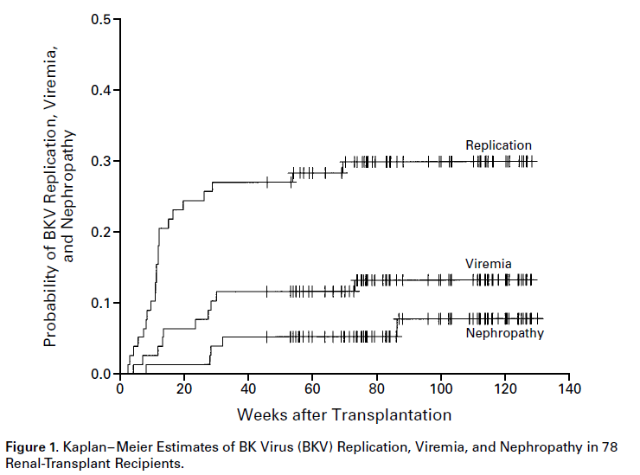
BKPyV after kidney transplant
Hirsch HH et al Prospective study of polyomavirus type BK replication and nephropathy in renal-transplant recipients. N Engl J Med. 2002 Aug 15;347(7):488-96.

Slide 26
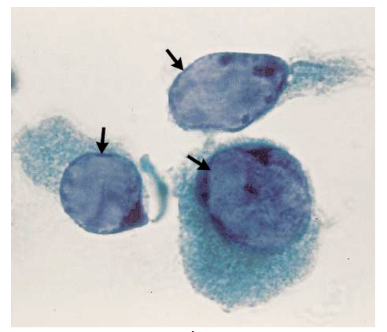
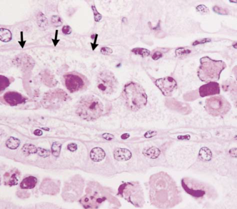
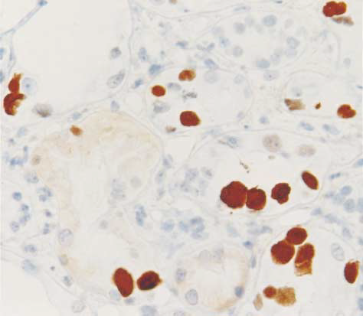
BKPyV after kidney transplant
Decoy Cells
Nephropathy
LTA staining
 | To detect biopsy-proven BK virus nephropathy
 | Sens | Spec | PPV | NPV
Decoy cells in urine | 100% | 71% | 29% | 100%
Viremia | 100% | 88% | 50% | 100%
All subjects with nephropathy had BKPyV viremia:
≥ 7700 copies/mL
Hirsch HH et al. N Engl J Med. 2002;347(7):488-96. Nickeleit V et al. N Engl J Med. 2000;342(18):1309-15.

Slide 27
Biologic significance of viremia 10,000 copies/mL
Viruses replicate on a logarithmic scale
Adenoviremia >10,000 copies/mL associated with clinical disease (Lee et al, BBMT, 2013)
Further BKPyV viremia data:
1000 copies/mL=1 lysed tubular cell/day
50,000 copies/mL= 125,000 lysed tubular cells/day (Funk and Hirsch, CID, 2009)

Slide 28
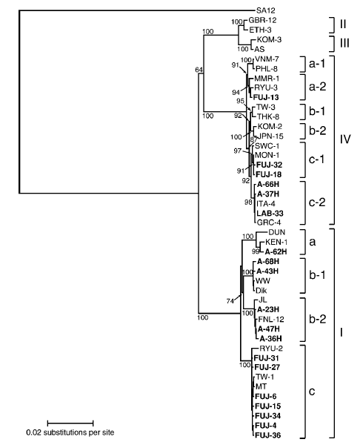

Is the 10,000 cutoff valid across centers?
Kidney transplant case report:
National reference laboratory showed a BKPyV load <325 copies/mL
Testing at the treating institution had BKPyV loads of 46,000-86,000 copies/mL
Patient had biopsy-proven nephropathy
The patient was infected with BKPyV genotype IV
BKPyV exists as 4 genotypes with geographic and evolutionary variation!
Zhong S et al. J Gen Virol. 2009; 90(Pt 1):144-52.
Trofe-Clark J, et al. Am J Transplant. 2013 Apr;13(4):1112-3.

Slide 29
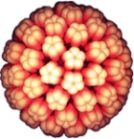
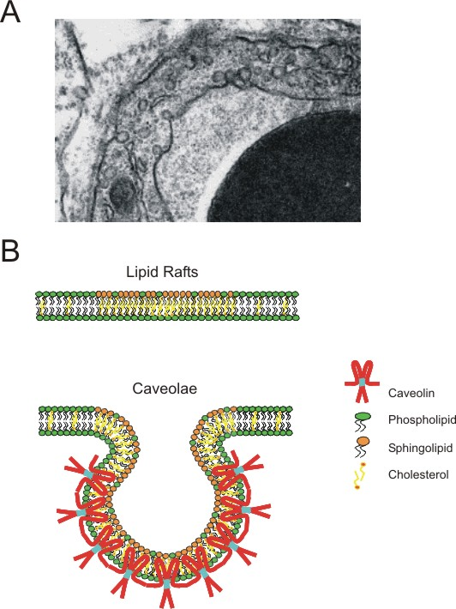

Immune Control
Similar to CMV/EBV, virus-specific T-cells control BKPyV infection
Antibodies may neutralize infection or be a “marker” of cell-mediated viral control
Alternatively, humoral responses may help to clear BKPyV from the blood, but be less effective at the site of intracellular tissue injury in the kidney or bladder
BKPyV endocytosis occurs slowly, potentially allowing greater time for neutralizing antibodies to prevent infection
Dugan AS, et al. Transpl Infect Dis. 2006

Slide 30
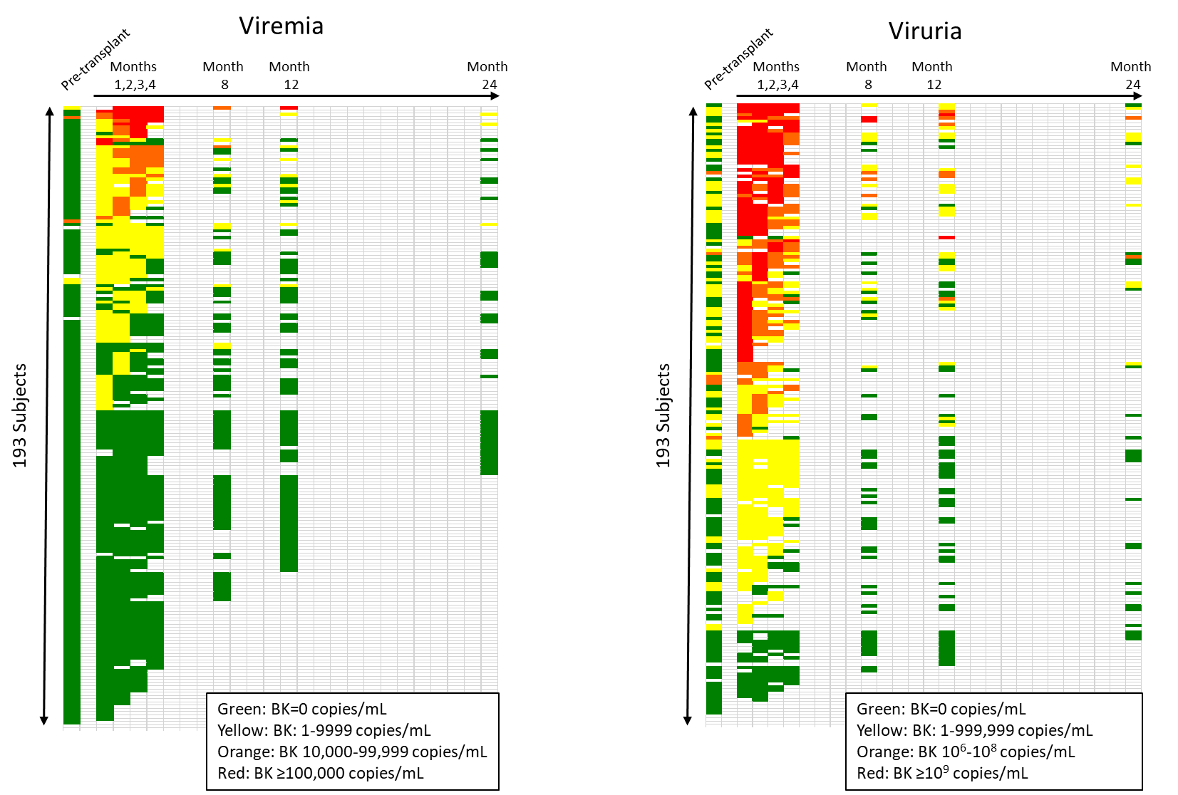
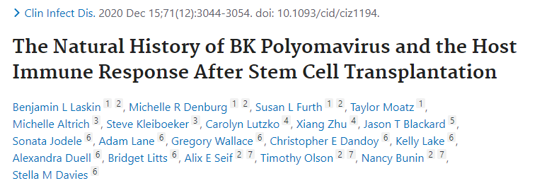
1070 blood samples, median 6 per subject
97% were negative for viremia pre-HCT
47% had post-HCT viremia
19% had peak viremia ≥10,000 copies/mL

Slide 31
 | Peak Viremia in first 3 month |  |  | Peak Viruria in first 3 months
 | <10,000 copies/mL | ≥10,000 copies/mL | p-value | <10⁹ copies/mL | ≥10⁹ copies/mL | p-value
 | N=149 | N=34 |  | N=87 | N=70
Acute GVHD grade ≥2 | 26% | 47% | 0.02 | 23% | 41% | 0.02
TMA | 35% | 79% | <0.001 | 34% | 60% | 0.01
Acute kidney injury | 34% | 35% | 0.84 | 30% | 40% | 0.24
Received dialysis | 3% | 18% | 0.006 | 4% | 9% | 0.19
Overall survival at 1 year | 88% | 70% | 0.001 | 86% | 83% | 0.30
 | Median glomerular filtration rate (ml/min/1.73m²)
Baseline | 131 | 132 | 0.41 | 130 | 131 | 0.77
Month 8 | 121 | 98 | 0.10 | 125 | 116 | 0.35
Month 12 | 126 | 110 | 0.04 | 119 | 124 | 0.84
Month 24 | 125 | 98 | 0.004 | 125 | 112 | 0.33

Slide 32
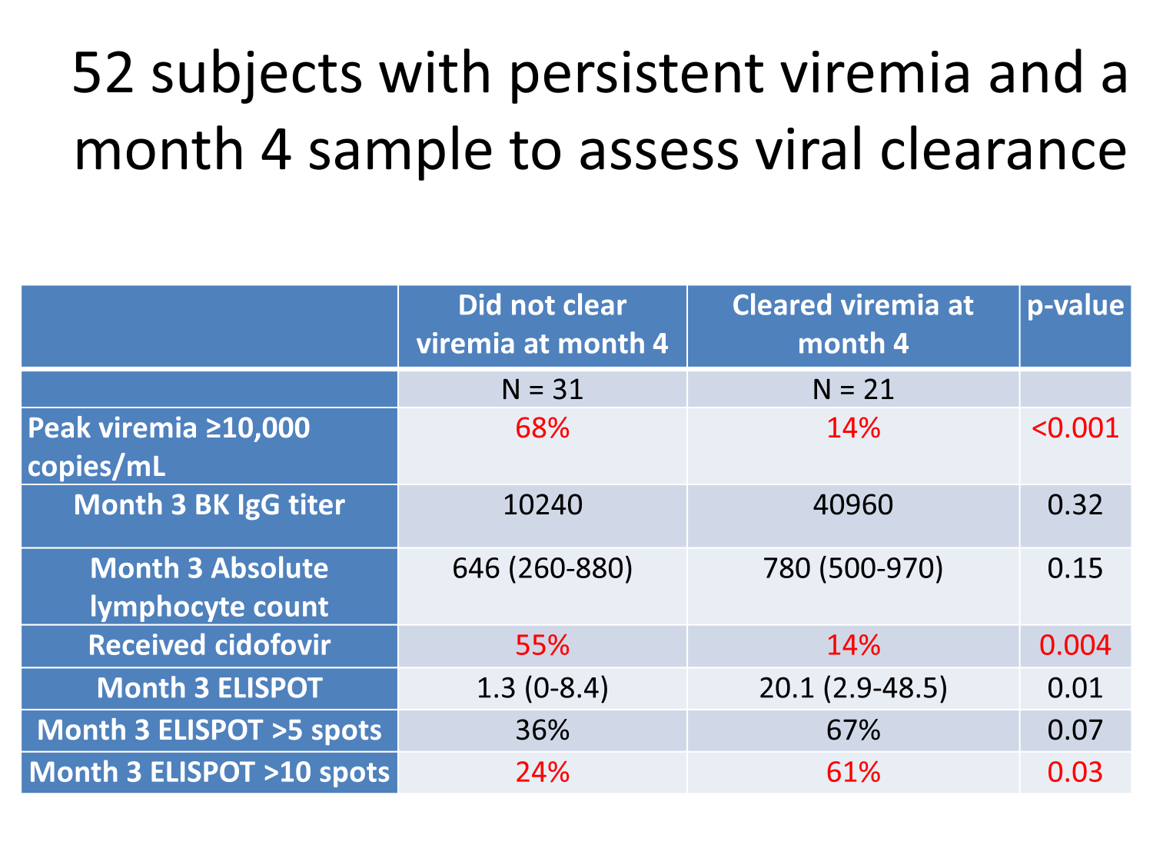

Slide 33
Poll 3: Which treatment has the most evidence for success for BK infection?
Choose one
Leflunomide
IVIG
Cidofovir
Ciprofloxacin
Lowering immunosuppression

Slide 34
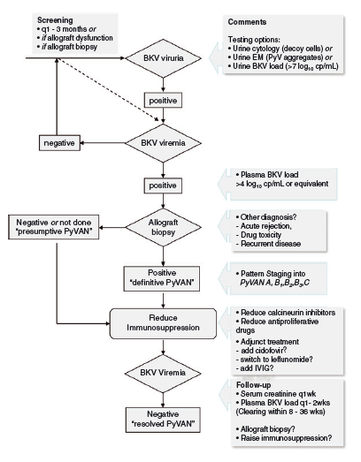
Treatment
Screening and therapeutic interventions:
Antivirals or infusion of donor derived virus specific T-cells
In the highest risk patients:
Persistent BK viremia and an absent T-cell response
Hirsch HH et al. Am J Transplant. 2013; 179-88

Slide 35
Poll 4: What does you program do for surveillance of BK?
You may choose more than one option
Urine PCR
Blood PCR
Decoy cells
BK virus serology (antibody)

Slide 36
Subsequent Course
Pre biopsy: tacrolimus and sirolimus targets decreased
Post biopsy: Started IVIG, Leflunomide
Also d/c tacro and switch to everolimus
IVIG + Leflunomide

Slide 37
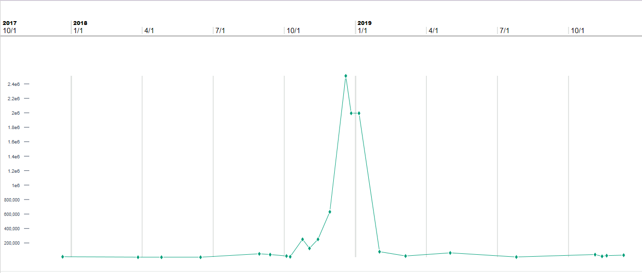
BK Virus quantification
Intraop characteristics
  Donor kidney with two arteries, two veins
  Hypotension in the OR→ got fluid bolus with appropriate response
  Donor blood culture positive for MSSA
Induction with ATG/Methylpred
Due to previous FSGS, got plasmapheresis pre transplant and on POD #1, 2, 4; got IVIG on POD#3
Post op urine output 0.5-0.6 mL/kg/hr (500-600 mL/day)
2.5 Million
Cidofovir
IVIG + Leflunomide
Leflunomide
251K
10000
50019
19025
3162

Slide 38
Current Status
CKD Stage 3 with creatinine of 2.5-3
Low grade BK viremia- 100-500 copies
Current medications:
  MMF
  Tacrolimus
  Leflunomide

Slide 39
Thank You
Thanks for participating in our renal pathology session
Please let us know if you have any interesting cases for us to discuss in the future
Please contact us with any questions or if you would like to connect to our content experts.
    Joann Spinale Carlson: Joann.Carlson@rutgers.edu
    Robin Kremsdorf: rkremsdorf@Lifespan.org
    Shina Menon: shina.menon@seattlechildrens.org
    Brian Stotter: bstotter@wustl.edu
    Patrick Walker: patrick.walker@arkanalabs.com

